Slide 1


Box layout standard
Title
Segoe UI 15 pt;
Two lines maximum;
Align text to top-left of box
Forms
Preview
Subtitle
Segoe UI 10 pt italics;
One line maximum
Share Icon
Full share, half share, or no icon
App Icon
PNG with transparent background;
Should be approx 1/3 width of box (go by width, not height);
Centered on box horizontally
Description
Rakesly Book 12 pt;
Two lines maximum (three if absolutely necessary);
Align to bottom-left of box
Simple forms & polls [SurveyMonkey]
Cost Icon
Included if product is premium
Note: font sizes are provided as guidance for how large they should be in comparison to each other. They aren’t dictated to be identical in the dynamic version.

Slide 2
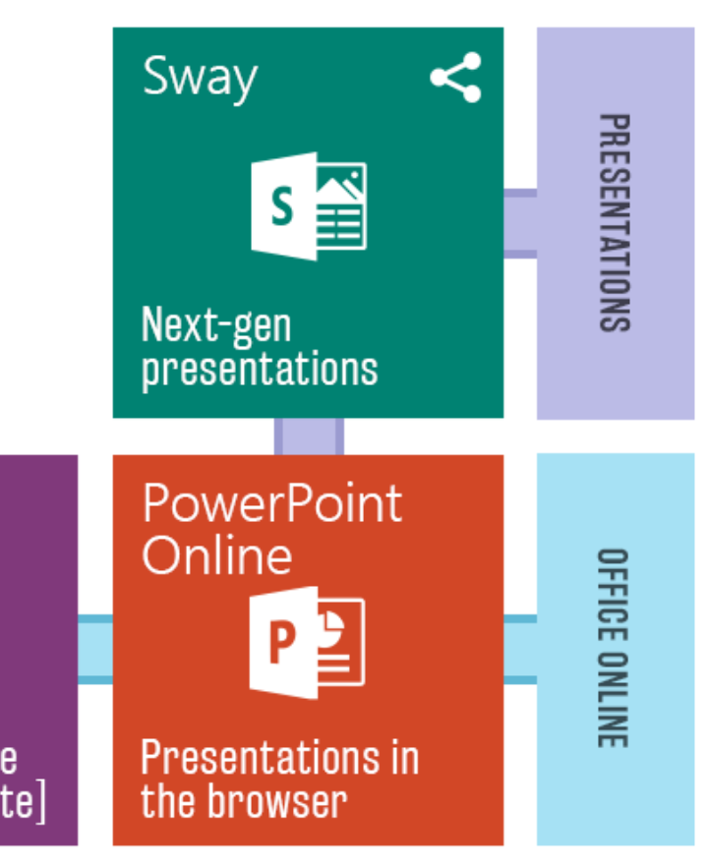
Grouping layout standard
Title
Rakesly Regular 10 pt all caps;
Two lines maximum;
Align text to center of box;
Box about 1/3 width of an app box
Colors
Purple
Main: bbbbe6
Outline: 9b9bd0
Blue
Main: a6e1f4
Outline: 5fb8d5
Green
Main: b3e6a9
Outline: 7ccd6d
Grouping Lines
About 1/6 the width of a box;
Centered vertically or horizontally depending on its use case

